Slide 1
Earned Value Management
What is Earned Value Management (EVM)?
Simply, it is a project monitoring and measurement system that establishes a clear relationship between planned accomplishments and actual accomplishments
A method of integrating scope, schedule, and resources, and for measuring project performance.
It compares the amount of work that was planned with what was actually earned with what was actually spent to determine if cost and schedule performance are as planned.
59

Slide 2
Earned Value Management
What is needed for EVM?
A baseline plan
A project budget (BAC – Budget at Completion)
A project end date
Tasks are identified & scheduled
Each task has a budget or effort (resource loaded / weighting)
Actuals tracked
59

Slide 3
Earned Value Management
To perform EVM, three values need to be determined
Planned Value (PV or BCWS) Budget Cost of Work Scheduled
Actual Costs (AC or ACWP) Actual Cost of Work Performed
Earned Value (EV or BCWP) Budgeted Cost of Work Performed
59

Slide 4
Earned Value Management
Planned Value (PV)
What are the budgeted costs of the work scheduled?
  Time phased based on baseline budget
  Only changes when baseline is changed
  Also referred as “BCWS” & “BAC”
60

Slide 5
Earned Value Management
Actual Costs (AC)
What are the actual costs of the work performed?
  Based on the actual completion of work packages
  Actual costs for reported work
  Also referred as “ACWP”
60

Slide 6
Earned Value Management
Earned Value (EV)
What are the budgeted costs of the work performed?
  Based on the actual completion of work packages
  Baseline value of the reported work
  Also referred as “BCWP”
60

Slide 7
Earned Value Management Example
Task – Drill & install 10 piezometers
Budget - $100,000 ($10K per piezometer)
Time – 10 weeks (1 piezometer per week)
At week 5:
4 piezometers drilled and installed
$47,500 spent to date
PV = $50,000
AC = $47,500
EV = $40,000

Slide 8
Earned Value Management
Calculating Earned Value and interpreting results
to measure the progress of the project
help identify trends
forecast costs
and identify ways to correct/mitigate project pitfalls.
60

Slide 9
Earned Value Management
Cost Variance (CV)
CV = EV - AC
Good News: If CV value is positive, the project is currently under budget (spending less than planned for the work)
Bad News: If CV value is negative, the project is currently over budget (spending more than planned for the work)
60

Slide 10
Earned Value Management
Cost Performance Index (CPI)
CPI = EV / AC
Good News: If CPI value is >1 or =1, the project cost trend is currently under or at planned budget
Bad News: If CPI value <1, the project cost trend is currently over budget
60

Slide 11
Earned Value Management
Cost Variance % (CV%)
CV% = CV / EV
Good News: If CV% value is positive, the project is currently under budget by the CV%
Bad News: If CV% value is negative, the project is currently over budget by the CV%
60

Slide 12
Earned Value Management
Schedule Variance (SV)
SV = EV - PV
Good News*: If SV value is positive, the project is currently ahead of schedule
Bad News: If SV value is negative, the project is currently behind schedule
* - not all positive SVs are good
61

Slide 13
Earned Value Management
Schedule Performance Index (SPI)
SPI = EV / PV
Good News: If SPI value is >1 or =1, the project schedule trend is currently ahead or on planned schedule
Bad News: If SPI value <1, the project schedule trend is currently behind schedule
61

Slide 14
Earned Value Management
Schedule Variance % (SV%)
SV% = SV / PV
Good News: If SV value is positive, the project is currently ahead of schedule
Bad News: If SV value is negative, the project is currently behind schedule
61

Slide 15
Earned Value Management
Estimate at Completion (EAC)
#1
Actual costs to date plus a new estimate for all remaining work (original plan no longer valid)
EAC = AC + ETC
(ETC ➔ Estimate to Complete)
61

Slide 16
Earned Value Management
Estimate at Completion (EAC)
#2
Actual costs to date plus remaining budget (current variances are viewed as atypical of future variances)
EAC = AC + BAC - EV
61

Slide 17
Earned Value Management
Estimate at Completion (EAC)
#3 & #4
Actual costs to date plus remaining budget modified by a performance factor (CPI) (current variances are viewed as typical of future variances).
EAC = AC + [(BAC - EV) / CPI]
EAC = BAC / CPI
62

Slide 18
Earned Value Management Example
Task – Drill & install 10 piezometers
Budget - $100,000 ($10K per piezometer)
Time – 10 weeks (1 piezometer per week)
At week 5:
4 piezometers drilled and installed
$47,500 spent to date
PV = $50,000
AC = $47,500
EV = $40,000
CV = -$7,500
CPI = 0.82
CV% = -19%
SV = -$10,000
SPI = 0.80
SV% = -20%

Slide 19
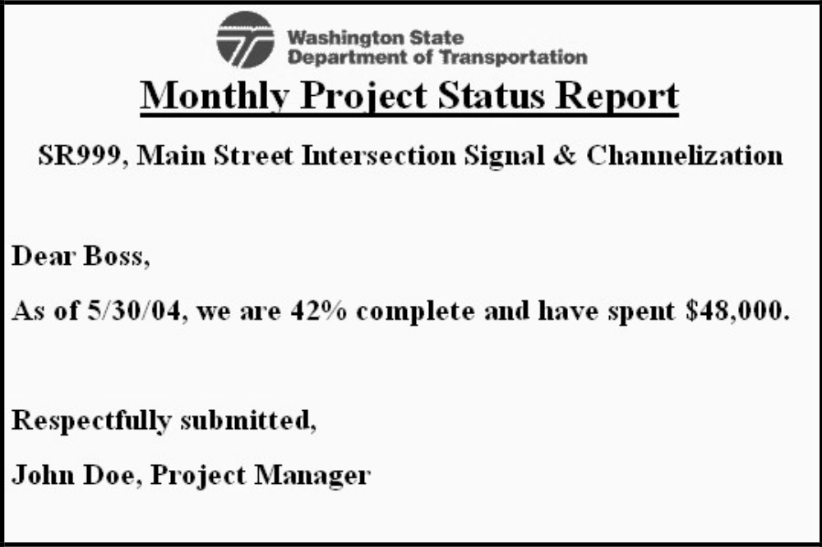
Earned Value Scenario
62

Slide 20
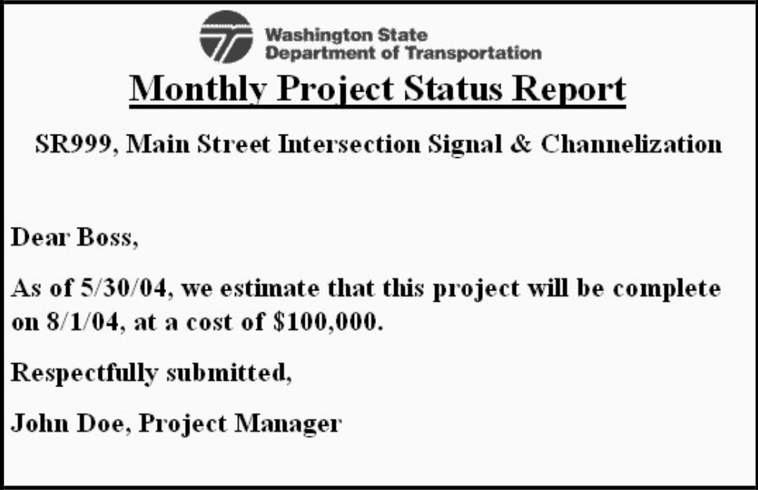
Earned Value Scenario
63

Slide 21
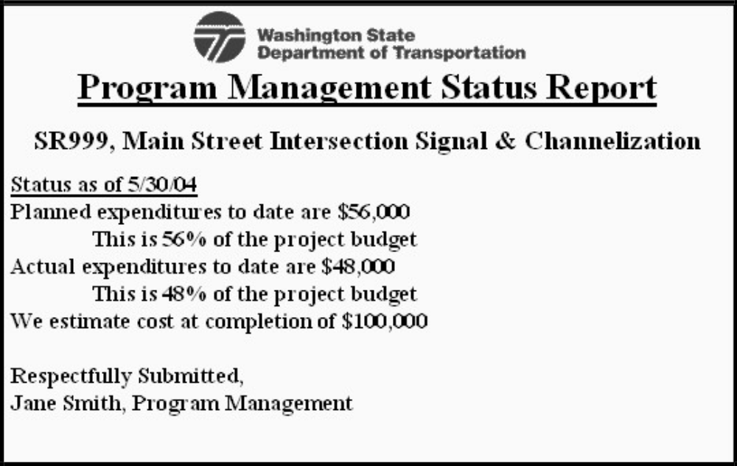
Earned Value Scenario
64

Slide 22
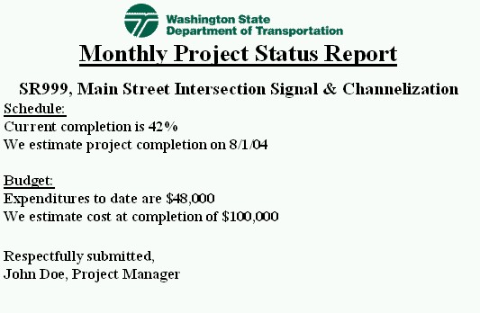
Earned Value Scenario
65

Slide 23
Earned Value Scenario
BAC = $100,000 (current project budget)
EV = $42,000 (42% of project completed, $100,000 planned)
PV = $56,000 (56% of project planned $100,000 completed – initial aging report)
AC = $48,000 (from actual expenditures reporting)
Is this project on schedule / budget? Or is it in trouble?
65

Slide 24
Earned Value Scenario
Cost Variance (CV):
CV = EV – AC
= $42,000 - $48,000
= - $6,000
Cost Performance Index (CPI):
CPI = EV / AC
= $42,000 / $48,000
= 0.875
Cost Variance % (CV%):
CV% = CV / EV
= - $6,000 / $42,000
= 14% OVER BUDGET
66

Slide 25
Earned Value Scenario
Schedule Variance (SV):
SV = EV – PV
= $42,000 - $56,000
= - $14,000
Schedule Performance Index (SPI):
SPI = EV / PV
= $42,000 / $56,000
= 0.750
Schedule Variance % (SV%):
SV% = SV / PV
= - $14,000 / $56,000
= 25% BEHIND SCHEDULE
66

Slide 26
Earned Value Scenario
Estimate at Completion (EAC):
Method #1:
EAC = AC + ETC (say $68,000)
= $48,000 + $68,000
= $116,000
(Change Management for $16,000 funds request)
Method #2:
EAC = AC + BAC – EV
= $48,000 + $100,000 - $42,000
= $106,000
(Change Management for $6,000 funds request)
67

Slide 27
Earned Value Scenario
Estimate to Complete (ETC):
Method #3
EAC = AC + [(BAC – EV) / CPI]
= $48,000 + [($100,000 - $42,000) / 0.875]
= $48,000 + $66,285
= $114,285
(Change Management for $14,285 funds request)
Method #4
EAC = BAC / CPI
= $100,000 / 0.875
= $114,285
(Change Management for $14,285 funds request)
67

Slide 28
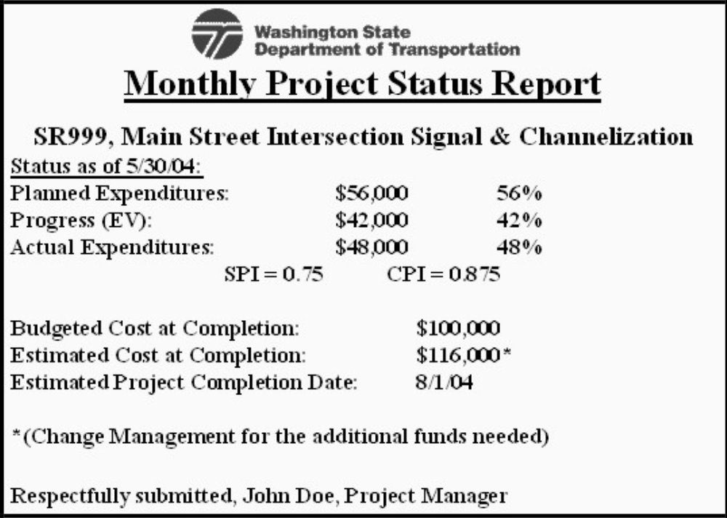
Earned Value Scenario
68

Slide 29
THANK YOU

